Slide 1



&
The road to enable DevOps beyond Facebook, Spotify, Netflix … within the Payment Industry
01 July 2016 Vincent van Kooten, Ingenico ePayments Gebrian uit den Bulten, Accenture
Notes:
ePayments, payment service provider, part of Ingenico Group mainly known for POS payment. Am no CTO , CIO or director … responsible for several scrum teams that work real-time app. Invited by Gebrian, he is the guru, shared mission to

Slide 2
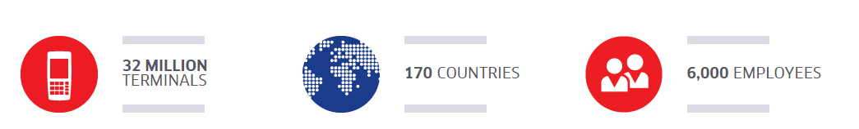


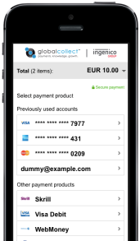

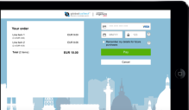

Where we fit in the organization
( 2014 )
( 2013 )

Slide 3

What is a “Payment Service Provider” ?

Slide 4





We turn your payment complexity …
Euro/GBP Acquirer
ProcessTransaction
USD Acquirer
Check Out Page
Asia Acquirer
Reporting
Netherlands
Merchant Back-Office Systems
Wallets
Fund Transfer
Merchant
... and others
Notes:
Epayments, pillars is online gaming. From chili to Russia

Slide 5

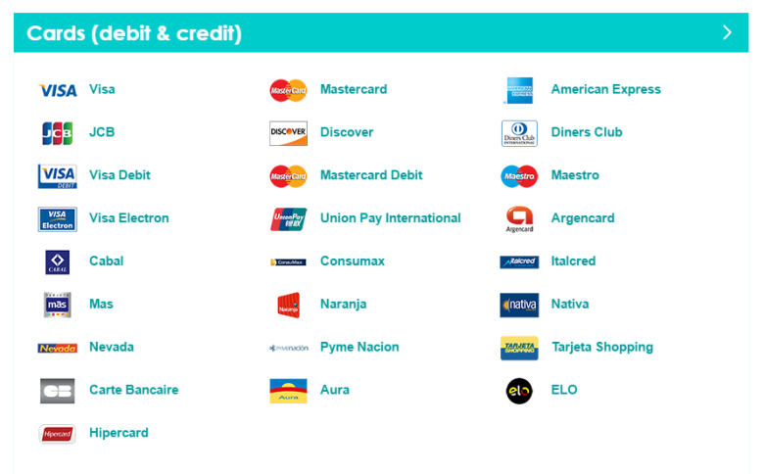


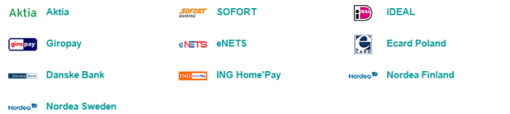


… into something easy!
Process transaction
Check Out Page
Reporting
Your Back-Office System
Ingenico Back-Office System
Funds transfer
£
£
€
€
$
$
Notes:
REST API, iOS SDK, Android SDK, sandbox environment, etc
My department processes the real time authorizations / payments
Millions of API calls

Slide 6
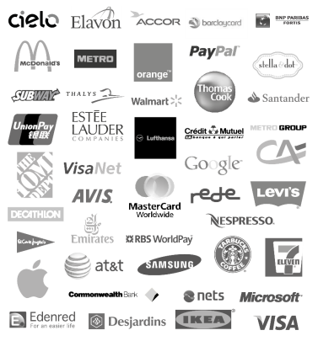





You’ve done business with us …
€58 Bn Processed flow
800+ Employees
65,000 Clients
230 Acquiring partners and banks
150 International, local and alternative payment methods
150+
170 Countries
Image source: https://www.theguardian.com/sport/picture/2016/may/26/sport-picture-of-the-day-sparks-fly-in-monaco-for-max-verstappen#img-1
Notes:
Ingenico: 32 million terminals
6000 employees
Tidal: Exclusive album releases such as Kanye West’s ‘Life of Pablo’ and Beyoncé’s ‘Lemonade’.

Slide 7

Shift away from the monolith
Ingenico ePayments started in 1994 as Payment Service Provider (PSP ).
Being a front-runner back then means dealing with older technologies today …
… so it was time for a ’big’ change.
Technical goals:
Refactoring from monolith into micro services architecture
Maintain 99.999% uptime
Maintain full automatic regression test (>25k test cases)
Easily handle over 1000s transactions per second
Delivery goals:
Move to a Agile / DevOps way of working
Introduction of the Continuous Delivery pipeline
Cloud enabled with technologies like containers
Maintain highest level of PCI compliancy
Image source: http://www.pinterest.com/pin/20195898298814935/

Slide 8



Learn from the best and improve on 3 themes:
organizational & cultural change
architecture enablement
continuous delivery
>_
Inspired by:

Slide 9
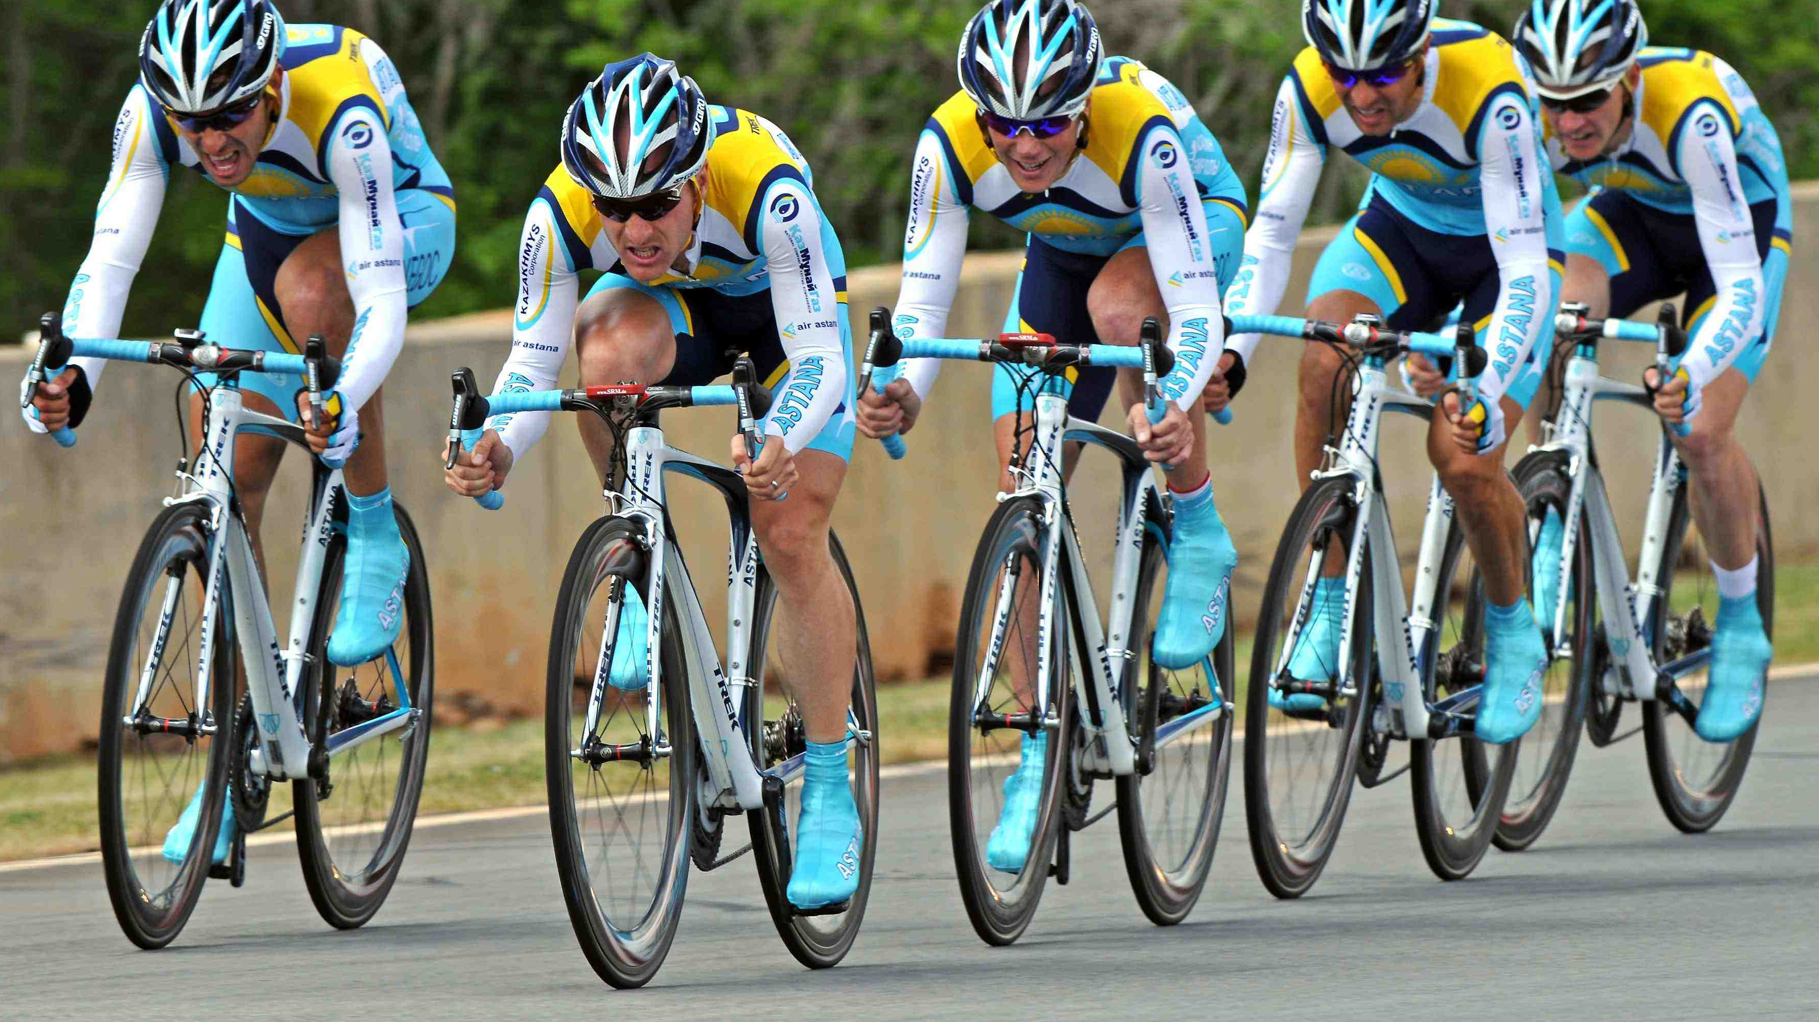
organizational & cultural change
Development is a team effort!

Slide 10
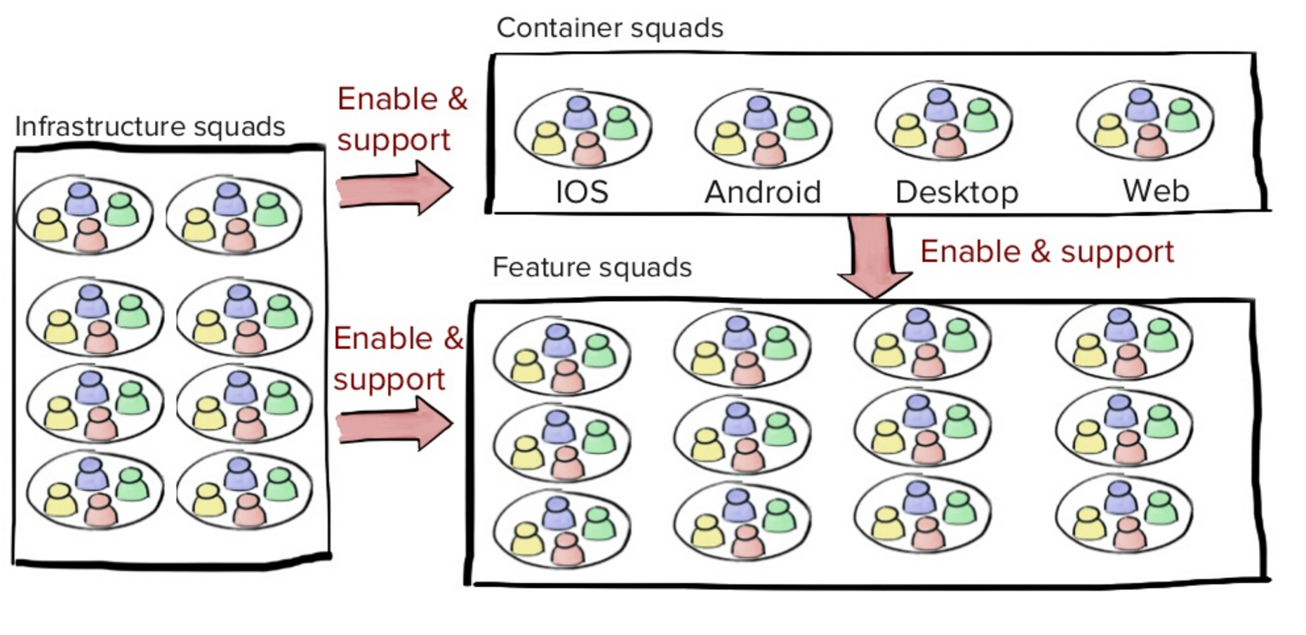
Goal: Self-service model
organizational & cultural change
The feature team should feel like a mini startup and should be
self organizing and be end-to-end responsible.
Image source: https://labs.spotify.com/2014/03/27/spotify-engineering-culture-part-1/

Slide 11
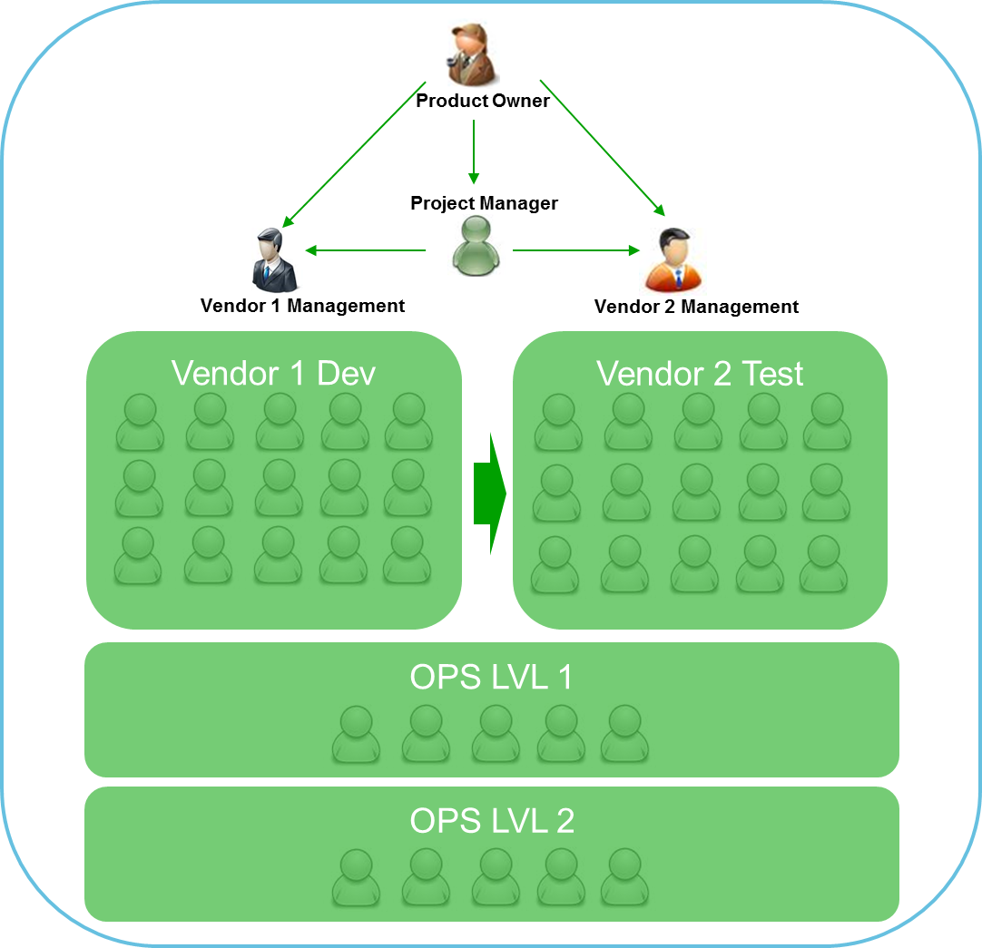
Previous Organization Setup
organizational & cultural change

Slide 12
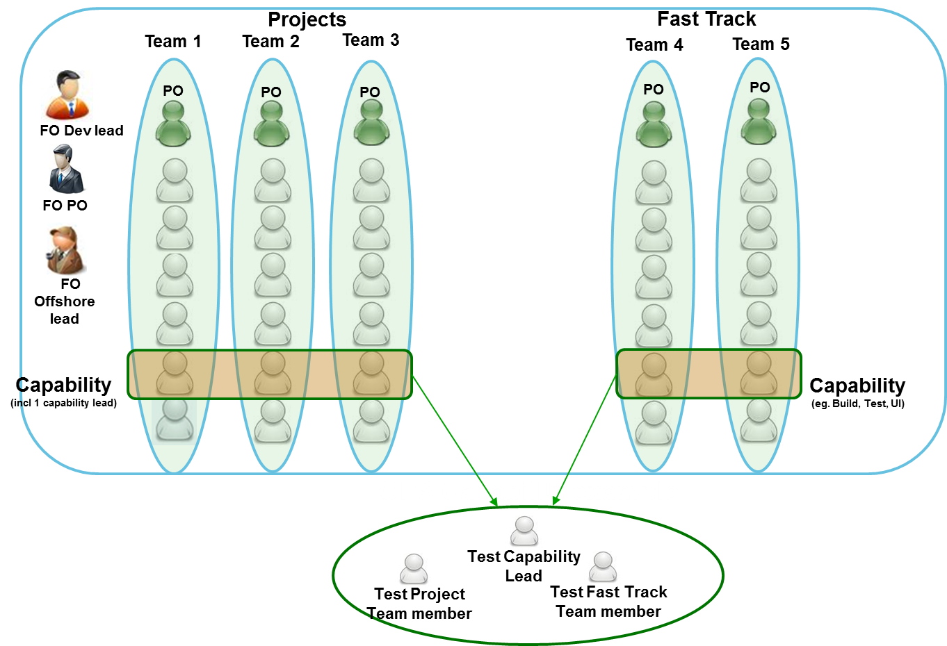
Current Organization Setup
organizational & cultural change
Projects
BAU & Enhancements
OPS
PCI
System team

Slide 13
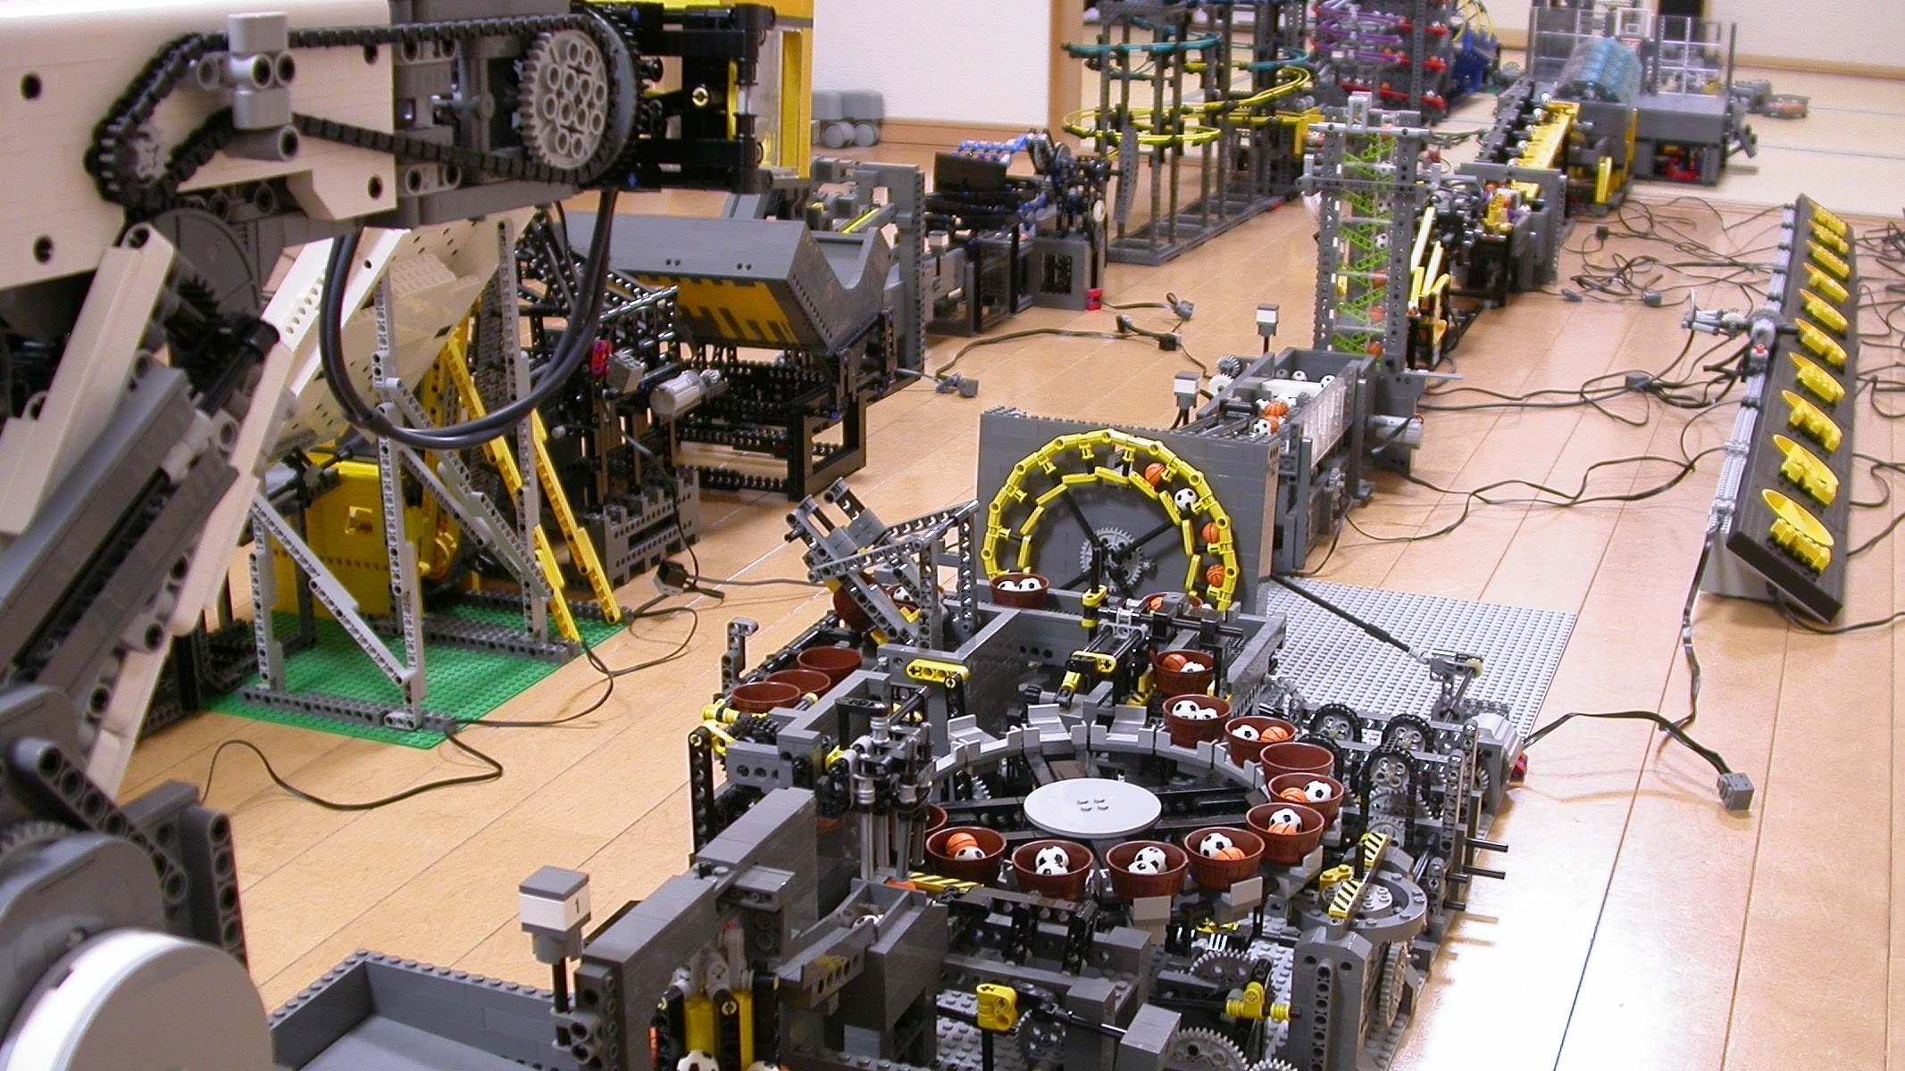
architecture enablement
Architecture as an enabler for CD

Slide 14
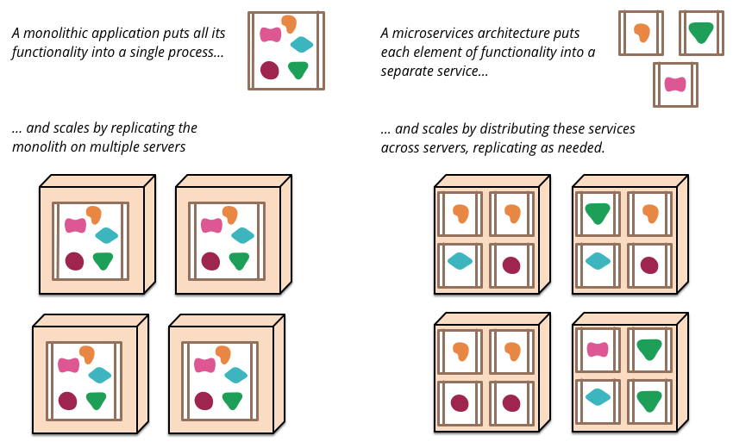
Goal: move to micro-services
architecture enablement
A monolithic application puts
all its functionalities into a
single process
and scales by duplicating
the monoliths
A micro-service architecture puts
each element on functionality into
a separate service
and scales by distributing
these services across servers

Slide 15

Setup the basic core architecture
architecture enablement
Legacy
GetOrderStatus(GOS)
Business logic
Application server Logic
Step 1:
Logging logic
Exception handling logic
Caching logic
Threading logic
Strangler Pattern
Image source: http://www.martinfowler.com/bliki/StranglerApplication.html
Legacy
Refactored
GOS Business Logic
Step 2:
GOS
Application server Logic
Logging logic
Exception handling logic
Caching logic
Threading logic

Slide 16

Move existing logic to the new platform by using the strangler pattern
architecture enablement
Legacy
PayPal
Refactored
GOS
Auth.
Step 3:
Existing
Business logic
*20+
SPM
Image source: http://cliparts.co/redwood-tree-clip-art

Slide 17
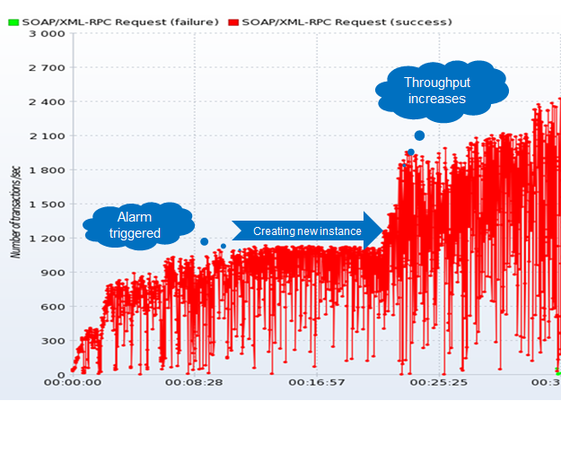
AWS & Docker to enable growth
architecture enablement

Slide 18
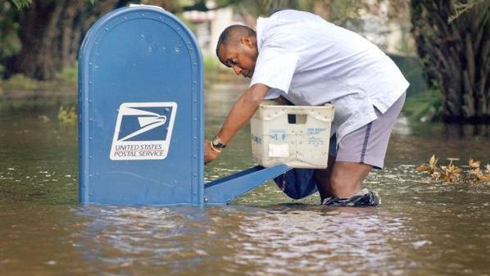
>_
continuous delivery
Commitment to deliver

Slide 19
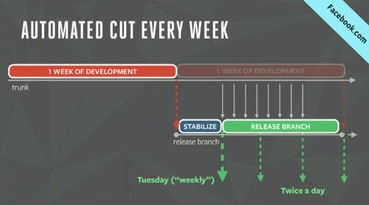
Goal: Release to production every day
>_
continuous delivery
https://www.infoq.com/presentations/Facebook-Release-Process
Image source http://www.agile-minds.com/facebook-mobile-release-process/

Slide 20
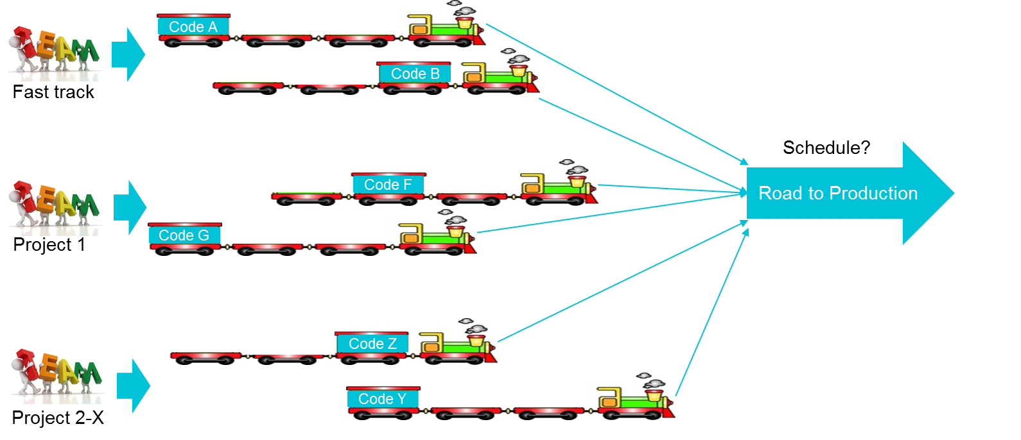
Previously releasing from multiple teams to production
>_
continuous delivery
Releasing to production <10 times a year
Takes months from code commit to move to production
High defect ratio in deliverables
Deployment of the platform to one environment could take day’s
Image source train: http://www.cartoon-clipart.com/cartoon_clipart_images/colorful_cartoon_choochoo_train_locomotive_steam_engine_toy_0515-1005-2200-3354.html
Image source team: http://mediapoliseuropa.com/index.php/team

Slide 21
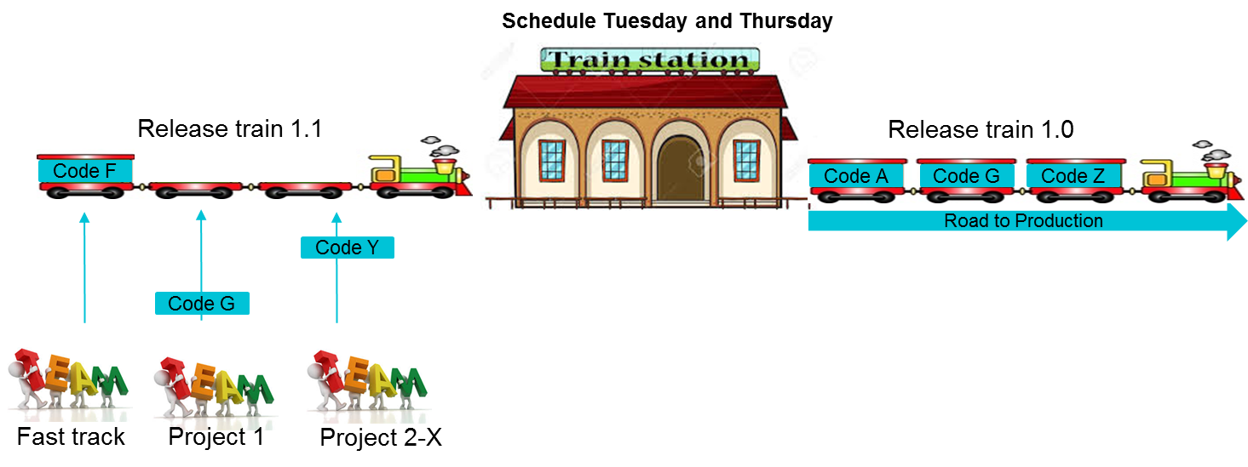
Releasing to Production
>_
continuous delivery
Releasing to production every week
On average a release would take around a week from code commit to production
Significant lower defect count in releases
Deployment to one environment of the platform takes less then an hour

Slide 22
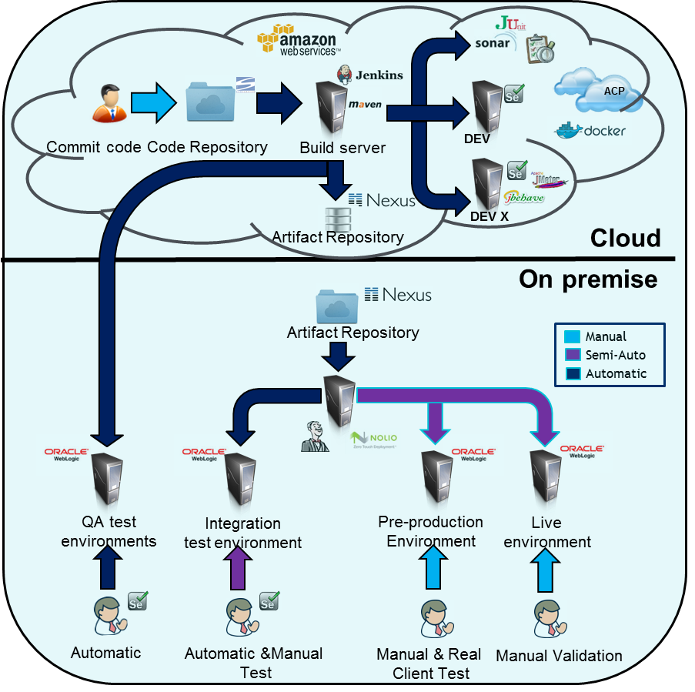
Current environment setup
Environment | Time | Tests
Build Server | On Commit | Unit test Integration unit test
Development | On Commit & Daily | Automatic Regression test Manual test
Test | On Demand & Daily | Manual test Performance test
Trunk | On Release & Daily | Automatic Regression test Performance test Manual smoke test
Integration Test | On Demand & Daily | Automatic Regression test User acceptance test
Pre-production | On Release | User acceptance test Real client test
Production | On Release | Validation test

Slide 23
Some lessons learned
Work closely together as one team instead of creating a vendor vs client relationship
No separation of teams based on onshore vs offshore. Mixed onshore & offshore is the key
Create mixed feature teams where business, dev. and ops are present
Additional management required for offshore (Team lead/ Scrum master Onshore and Offshore).
Set clear guidelines on dev, testing, automation, quality and enforce this through automatic tooling.
Mainline branching strategy is the key to enable continuous delivery don’t use feature branches!!
Don’t be afraid to choose a different direction if this fits better for your

Slide 24
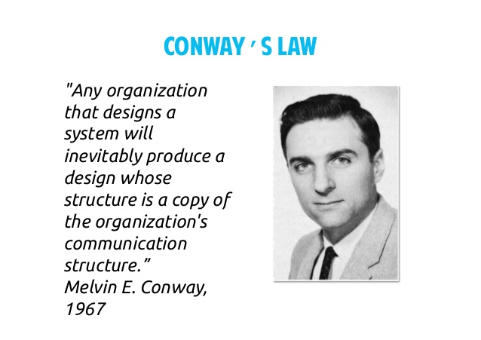
Next steps
Focus on creating feature teams
Increase development speed
Investigate cloud possibilities
Improve metrics
Continuous improvement!
Conway’s Law
“Any organization that designs a system will inevitably produce a design whose structure is a copy of the organization’s communication structure.”
- Melvin E. Conway, 1967
What can we still learn:
PCI compliancy in the cloud
Docker production experience on high profile, high load platforms, PCI compliant environments
http://www.slideshare.net/RachelDavies/tech-talk-implicationsconwayslaw

Slide 25

Don’t be afraid to change!
Contact information: Vincent van Kooten, Ingenico ePayments – www.linkedin.com/in/vincentvankooten Gebrian uit de Bulten, Accenture – www.linkedin.com/in/gebrian-uit-de-bulten-84974532
Image source: https://www.theguardian.com/sport/picture/2016/may/26/sport-picture-of-the-day-sparks-fly-in-monaco-for-max-verstappen#img-1

